Slide 1

IOT PROJECT INTERMEDIATE PRESENTATION
Anti-Theft Door System for Home Protection
By Group One
Notes:
NOTE:
To change the image on this slide, select the picture and delete it. Then click the Pictures icon in the placeholder to insert your own image.

Slide 2
Outline
Project Objectives
Component and Procedure
Achievements
Problem Solving

Slide 3
Project Objectives - Anti-Theft Door
We aim to develop a simple foot step detection system for entrance safety - for example, home protection.
The vibration sensor from the embedded system is supposed to detect the identity of the person entering the entrance.
Also, if a stranger whose footstep type is distinguishably different from the home member, the sensor should message the user with any possible unexpected entrance.

Slide 4
Apparatus and Procedure
The choice of microprocessor:
Raspberry Pi 3 board has more powerful processing ability than usual popular microprocessing board such as Arduino or Huzzah. Also, its GUI and OS in SD card enable us to process the data locally in an easier way.
However, compared to Arduino, it cannot read analog signal directly from sensor, for which reason we implement an ADC module for data collection from sensor.
Apparatus | Processor | Sensor
Screen | Raspberry Pi | Piezo Vibration
Keyboard | Arduino | Ultrasonic
Mouse

Slide 5
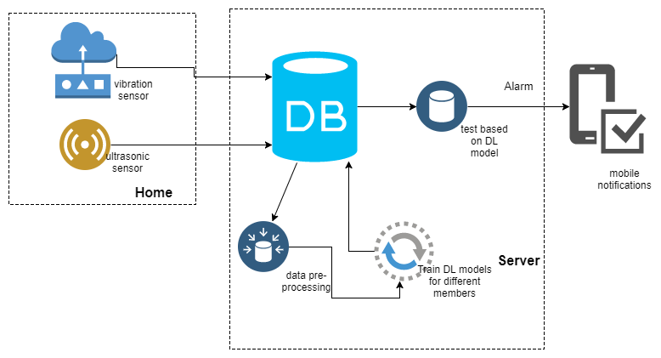
Project Diagram

Slide 6
Technology Usage
Embedded
System
Coding for Data Processing
Deep Learning Algorithm
Data Visualization
Raspberry Pi 3
Mongo
Database
Non-Linear
SVM
Send Email
Piezo Vibration Sensor
Arduino IDE
Python 3
Linux OS
Visualize
Score
Message
Notification
Ultrasonic Sensor
ADC Amplifier

Slide 7
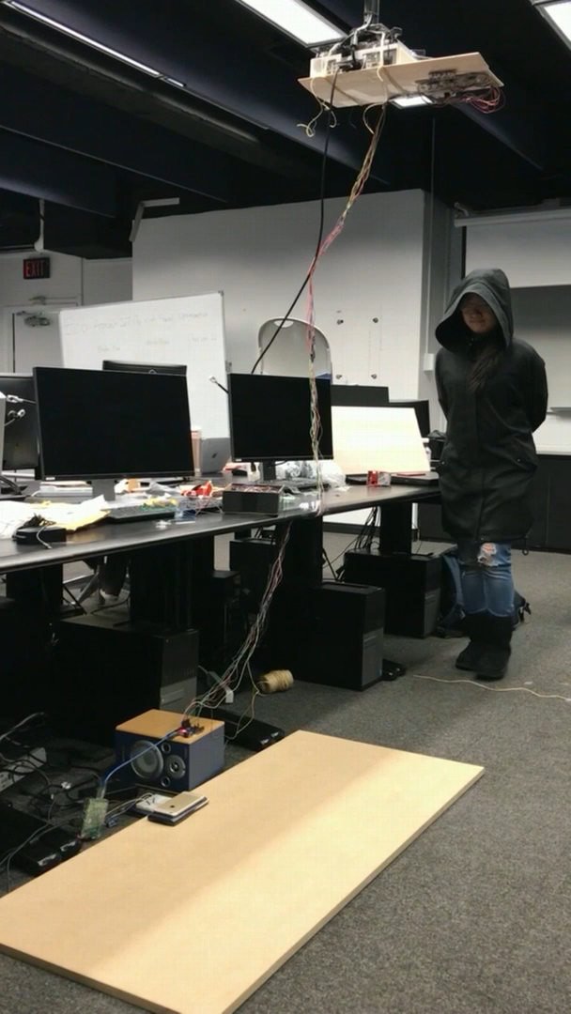
Identity Detection - member 1

Slide 8
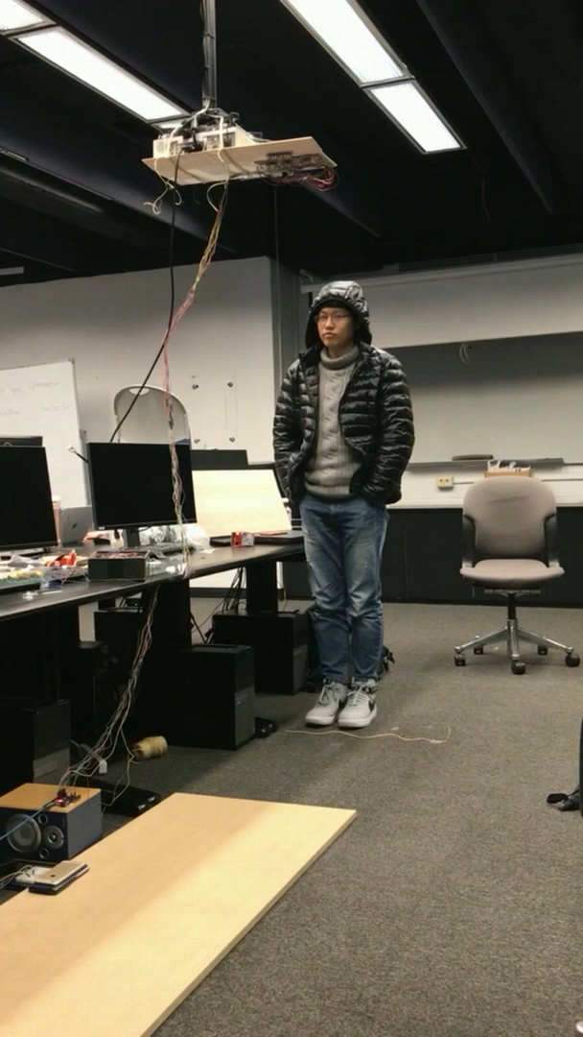
Identity Detection member 2

Slide 9
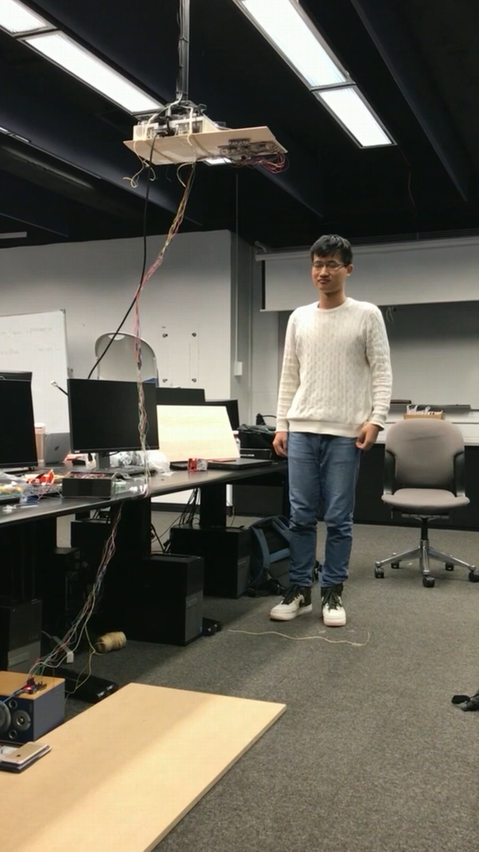
Identity Detection stranger

Slide 10
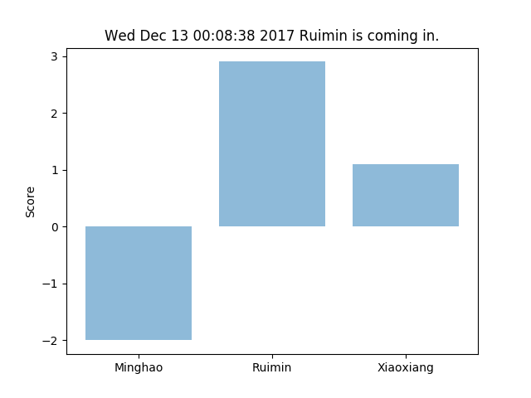
Result Visualization: Member One

Slide 11
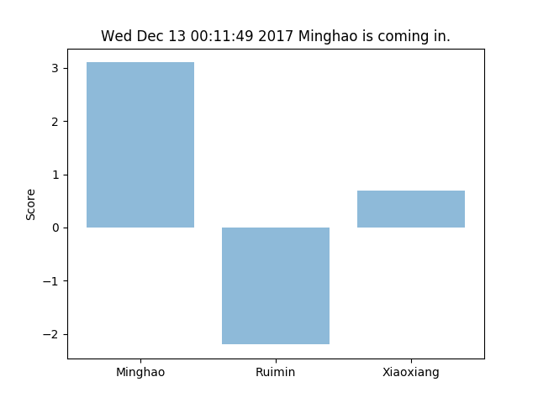
Result Visualization: Member Two

Slide 12
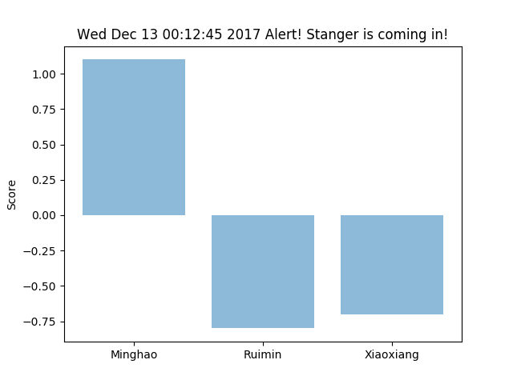
Result Visualization: Stanger

Slide 13
Goal Fulfillment
Bronze Goal: Build up the basic system which can detect the different family members.
Silver Goal: Design a warning-notification system to send message to the family members when there is a stranger entering the door.
Gold Goal: Involve figure detection using ultrasonic to assist our system so as to improve accuracy to close to 100%.
Implement piezo vibration sensor on the ground to increase accuracy, and connect them to the local cloud for data training.
Considering more complex situations, apply more types of sensors to design algorithm trying to distinguish family members and detect stranger.
Design a warning-notification system to send a message to the families if a stranger is detected.

